Slide 1
Dulla tvc commercial
Kapil Adhikari
22068805
M5

Slide 2
Agenda
Introduction about Project
Aim and objective
Concept Research
Process

Slide 3

INTRODUCTION TO THE PROJECT
The goal of this project was to create a branded, feel-good commercial advertisement for Dulla, a high-end luxury Nepali leather brand. Desk research and ideation to map a concept that works with the brand and speaks to its audience were the first steps in the process. This was complemented by the creation of a new media project, applying industry standards and practices across the preproduction, shooting and postproduction processes.

Slide 4

Aim and Objective
Slide 3: Aim & Objectives Aim: To produce a professional, visually engaging commercial that strengthens Dulla’s identity as a luxury lifestyle brand.
Objectives:
To highlight the craftsmanship and premium nature of Dulla’s leather products (bags, wallets, boots, shoes).
To create an elegant, visually minimalist video reflecting a modern lifestyle.
To meet platform standards and specifications for social media content.
To follow client feedback during development to maintain alignment with the brand image.
To improve visual storytelling and emotional engagement.

Slide 5
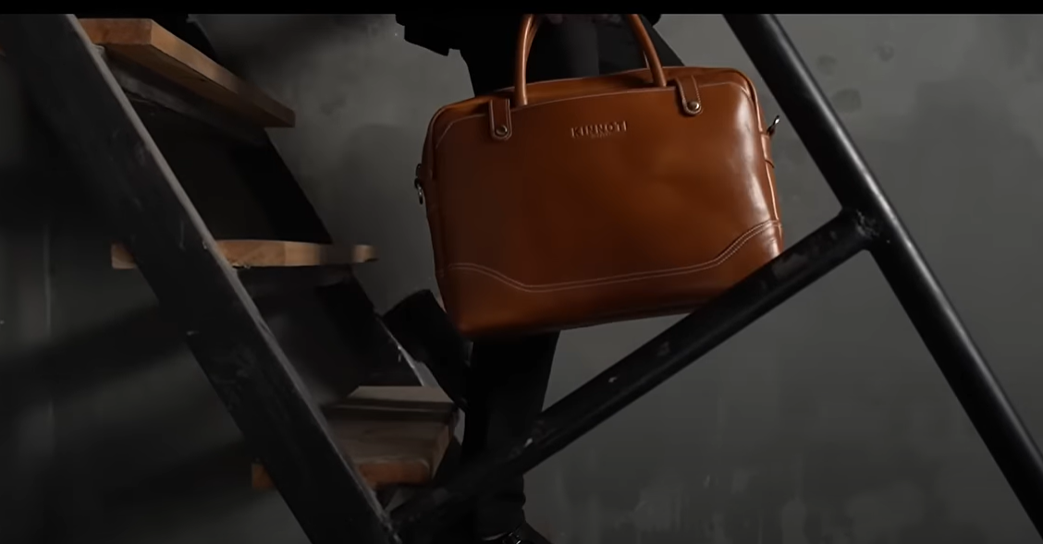
Concept Research
.
I observed brands like Berluti, Clarks Originals Which was in YouTube
These references supported in understanding the visual storytelling of premium brands.
We saw techniques such as dynamic lighting, close-ups, and beautiful pacing.
I based the mood, camera movement, and editing of my video off of research.
The simplicity along with class of those designs has inspired my direction.

Slide 6
Pre-Production Overview
Developed a pre-production process, a step-by-step guide for planning every detail ahead of the shoot.
It involved writing the script, creating a storyboard and scouting.
This stage also finalizes costume styling as well as time management.
This planning helped with no confusion during the shoot, thus more productivity and quality.
This stage was the Foundation of the whole video

Slide 7
Script Development
1. The script was written to reflect the core values of Dulla – elegance, craftsmanship, and modern sophistication.
2. It narrates the life of a character passing through daily activities seamlessly, letting the shoes and bags enter every scene effortlessly.
3. By avoiding dialogue and focusing on visual emotion, the script highlights how Dulla products enhance everyday moments
4. Each scene was carefully designed to emphasize lifestyle appeal, with subtle storytelling reinforcing the brand’s premium identity.

Slide 8
Storyboard Design
Storyboard was created to visualize scene in advance.​
Each shot was sketched to plans lighting anges and transition.
It helped save time and avoid wandering creatively during the shoot.
The storyboard also helped focus on product visibility in each frame.
​

Slide 9
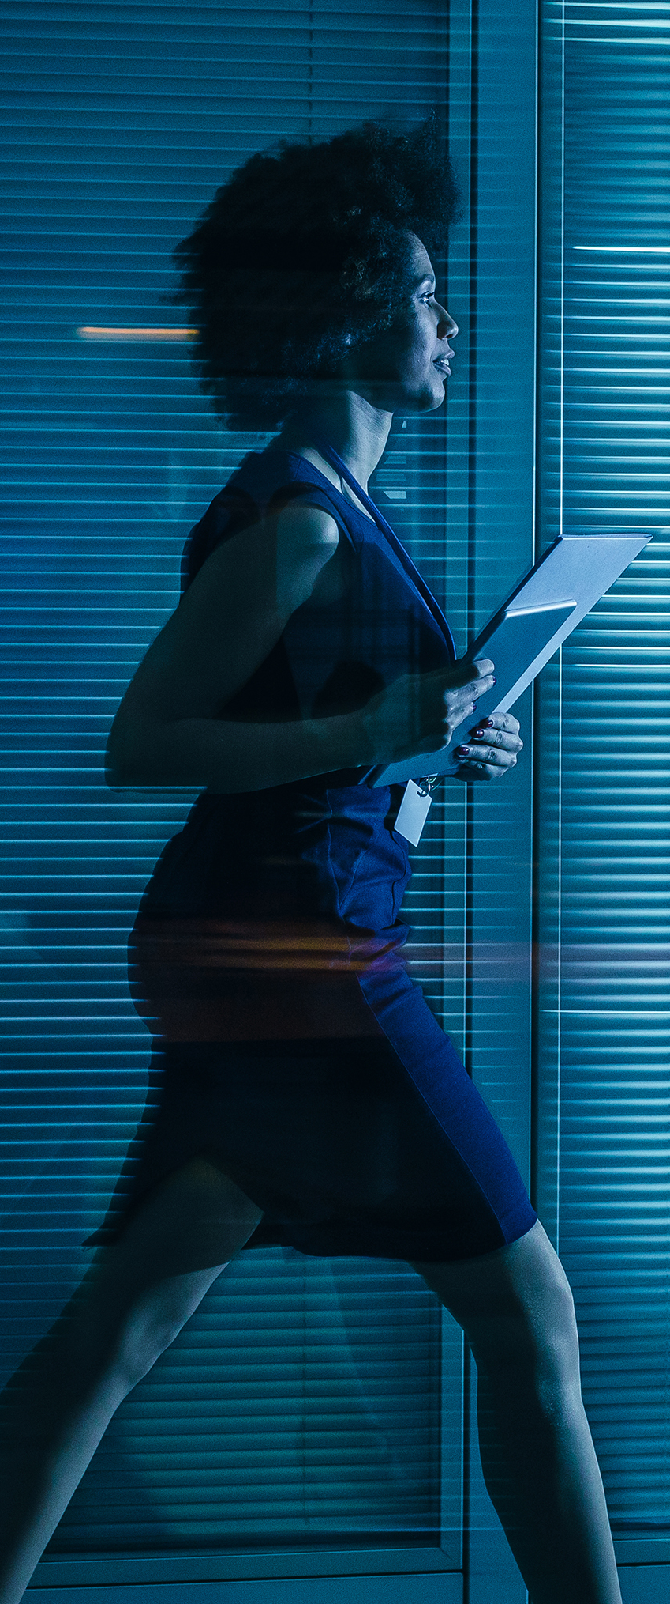

Location Planning ​
Location was one of the very first things to decide on and Taaj Palace was one of the first locations we decided upon due to its sophisticated, regal interior which matched Dulla's premium. positioning.
The rest of the shoot spanned a real office space, a café, and streets to capture an entire aspirational day in the life of the modern user.
I selected each space based on the theme of the lifestyle and how they would use the product in a realistic and relatable way.
The chosen locations which stood out because of their natural textures, lighting and architectural details were scouted for their visual value.
This mixture of indoor and outdoor scenes also keeps visual interest alive and reinforces a narrative connected to elegance and glamour.
These selected settings reflect the lifestyle of modern day aspirants that Dulla signifies.

Slide 10
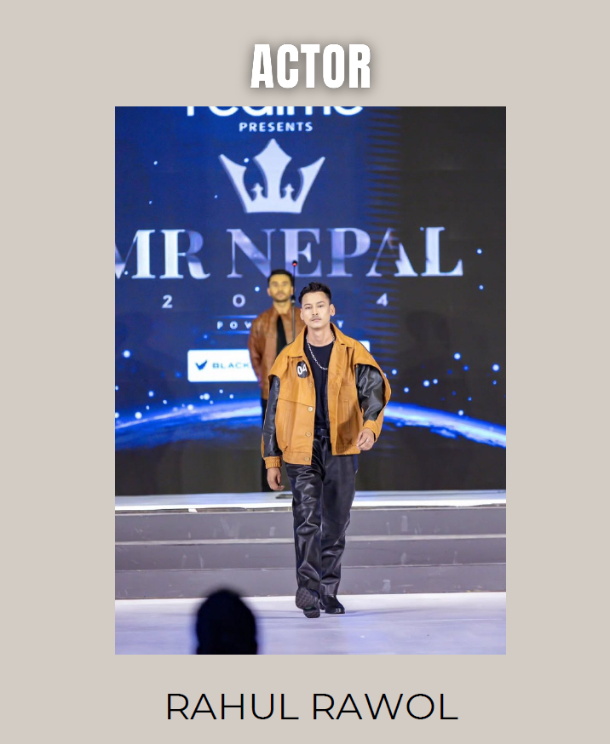
Casting and styling​
Initially, the selected model was unavailable, causing a delay in production.
Efforts were made to find a replacement, and eventually, a suitable male model was finalized who carried the refined, confident presence needed for Dulla’s image.
He wore formal clothing that aligned with Dulla’s elegant and sophisticated brand tone.
The styling approach was minimal and clean, allowing the shoes and bags to remain the central visual focus.
The model’s walk, posture, and movements were directed to reflect professionalism and elegance.

Slide 11
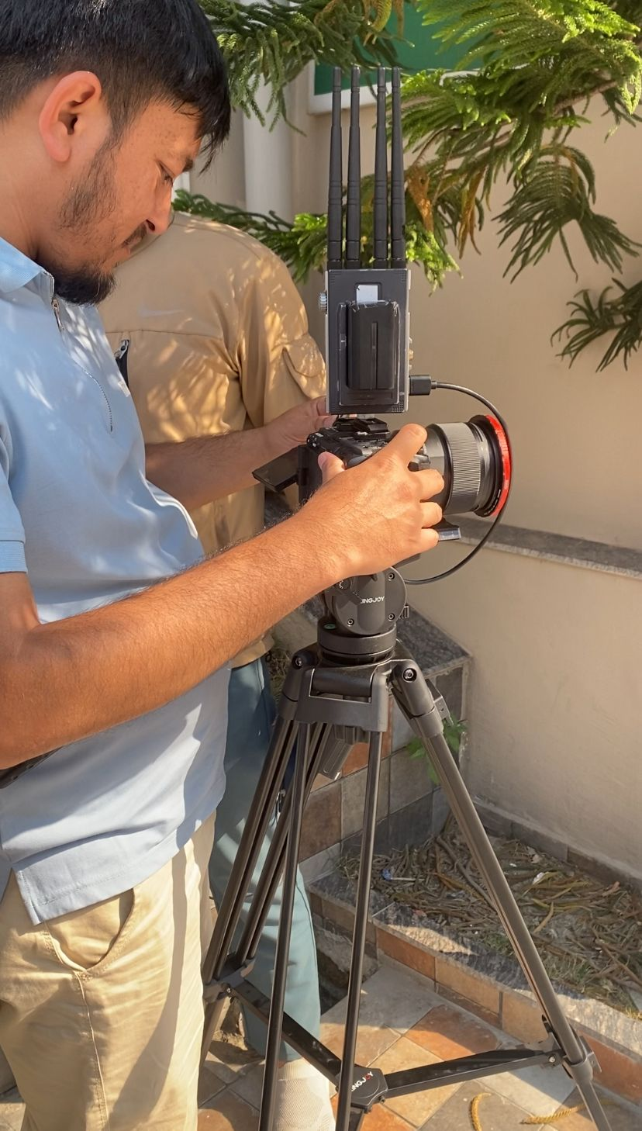
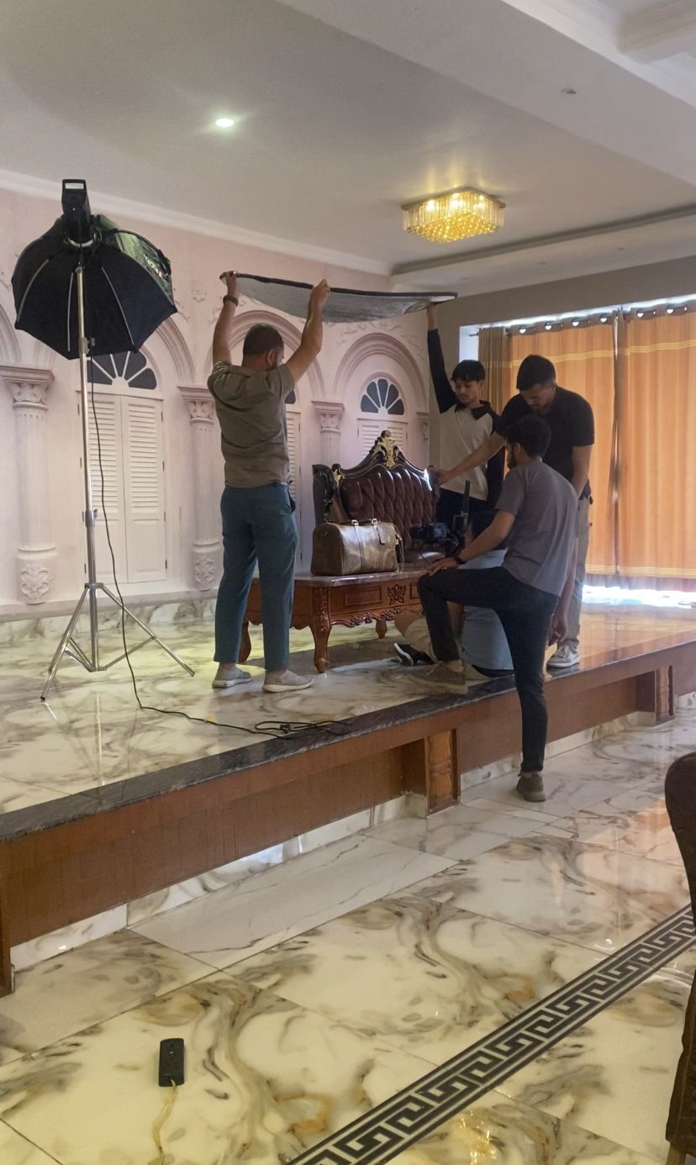
Production Phase
Throughout the day, footage was recorded at various locations within the plan of the setup.
It was filmed on a Sony FX3 camera, providing high-quality visuals and coupled with a tripod for stationary shots and a gimbal in all the dynamic shots.
In order to get everything as accurate as possible a real time shot on a Liliput LED screen was used to see the shots live.
We used three-point lighting to create depth and add a premium touch to the model and the products.
Light was mixed between natural and artificial, based on the needs of each of the shots.
The entire production stuck closely to the storyboard and script, providing for a strong visual narrative and littering with minimal product placement distraction

Slide 12
Filming techniques
These techniques comprise; close up shots wide angles shot & product angle.
The lighting was specifically tailored for even the creases in leather to shine.
A balance of handheld motion/tripod steadiness was used to keep realism and flow.
Set to make you feel something, camera height and distance were intentional choices.
It turned the advertisement into a much more premium experience due to the use of visual tools.

Slide 13
Camera Movement and Framing
1. Low-angle shots were used to convey power and confidence. 2. Centered framing kept attention on the model and products. 3. Slow pans and tracking shots added natural movement. 4. All shots were framed with a rule of thirds and depth in mind. 5. These choices helped create a cinematic look that matched luxury branding.

Slide 14
The schedule had to be adjusted earlier in the week as the original model canceled.
Through a friend I found a new model, then reworked the plan.
They had to reshoot some of the scenes which delayed the movie.
This tweaks was weather and lighting.
This was really problematic for my problem-solving and flexibility.
Challenges Faced

Slide 15
Post-Production Overview
1.Post-production involved editing, color grading, and audio integration.
2.This phase transformed raw footage into a professional ad. Cuts, transitions, and timing were carefully handled.
3.The mood of the video was crafted through visual pacing. This was where creative vision met final execution.

Slide 16
Editing with DaVinci Resolve
Editing with DaVinci Resolve
Video editing was done entirely on DaVinci Resolve.
Clips were arranged together with a little trim here or there, and set to music.
Transitions and Fade-ins were added for seamless transitions from scene to scene.
Tools like DaVinci helped at the final stages managing color, timing, detail, etc.
Just perfect for polishing and cinematizing.

Slide 17
Color Grading
1. Color grading gave the ad a warm, professional tone. 2.Natural skin tones were preserved while enhancing product color. 3.Shadows and highlights were balanced for depth and clarity. 4.Leather textures were made to pop subtly using contrast. 5.The overall palette matched Dulla’s sophisticated brand identity

Slide 18
Sound and Music
1. Non-copyrighted music was selected to suit the video’s theme.
2. It had a light, jazzy tone that added mood without distraction. Volume levels were adjusted to maintain balance with visuals.
3. No voiceover was used to keep focus on visual storytelling. Sound design helped unify the emotional and visual experience.

Slide 19
Final Rendering
Exported video to a full HD in high-quality codec.
It was cross-tested on various devices for legibility.
Playback was enabled as it was configured for smooth playback, since rendering was done as per settings.
Size of file was controlled for easy uploading and sharing.
The end result was creative and technical quality.

Slide 20
Techniques and Technology Used
1.The project used rule-of-thirds, low angles, and cinematic transitions. 2.Lighting was planned to enhance textures and tone. Editing techniques like speed changes and visual rhythm were applied. 3.The decisions were backed by research from top brand ads. These creative methods increased the value and quality of the adverisement.

Slide 21
In conclusion, this advertisement project for Dulla represents a comprehensive application of visual storytelling, brand alignment, and technical precision. From concept development through to post-production, each phase was carefully planned and executed to reflect the brand’s values of sophistication, quality, and contemporary style. The integration of researched production techniques, such as professional lighting setups and cinematic camera movements, ensured the final outcome was both visually compelling and commercially effective. By overcoming real-world challenges and maintaining creative consistency, the project successfully showcases Dulla as a premium lifestyle brand. This work stands as a testament to the value of thoughtful design, strategic planning, and adaptive problem-solving in the creation of high-quality branded content.

